Slide 1
Bird Migration Network
Exploring Effects on Migration Patterns and Hotspots
Anshul Choudhary - 21110028
Pratham Sagar - 21110165
Yashraj Deshmukh - 21110245

Slide 2
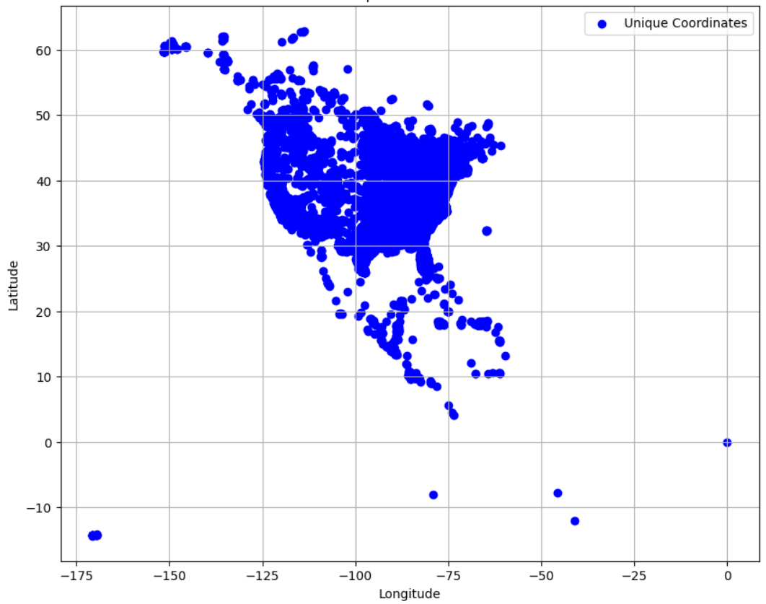
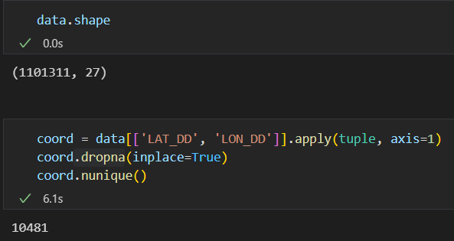
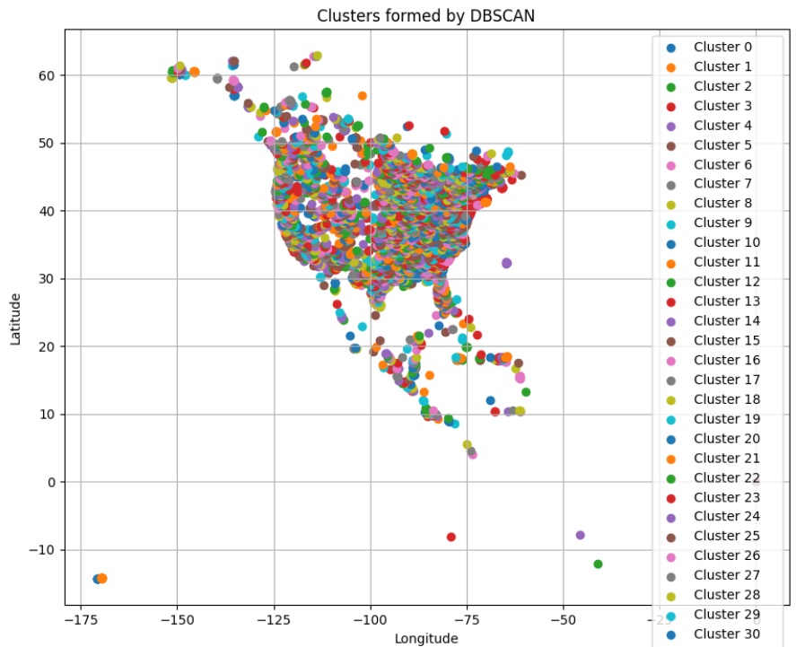
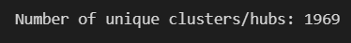
Preliminary Explorations
We worked on a csv file which had movement data on Cuckoos, Nightjars, Swifts, Hummingbirds in USA and tried out some testing on it. We did some preprocessing on the data to get rid of coordinate redundancy and nan values.
No. of clusters using DBSCAN algorithm (Max. dist. = 0.2 units)

Slide 3
What we are the nodes of our network?
How many nodes are we expecting?
What are the links/edges in the network?
Nodes are important bird areas.
We are expecting around 10,000 nodes spread mostly over the American and Asian continents, analysing potential hotspots for few species of migratory birds.
Edges will represent bird movement from one area to another. It consists of two attributes, namely, bird species and number of birds.

Slide 4
Why to care?
Do we have the data?
Many migratory bird species are deeply affected by human activities and climate change, some even on the verge of extinction in recent years. Through this project we wish to come up with a network which can be further developed to acquaint many more species and eventually save birds.
Need to find: Data used in Lee M, et al. (2007) Characterization of an H5N1 avian influenza virus from Taiwan. Vet 212 Microbiol 124(3):193-201.
Need to request: from datazone.birdlife.org (i) Species range map (ii) IBA boundary map
Currently Experimented on: Celis-Murillo, A., Malorodova, M., and Nakash, E., 2022, North American Bird Banding Program Dataset 1960-2022 retrieved 2022-07-14: U.S. Geological Survey data release, https://doi.org/10.5066/P9BSM38F.

Slide 5
Data Lookout
Smithsonian National Zoo data
BirdLife DataZone
MoveBank data

Slide 6
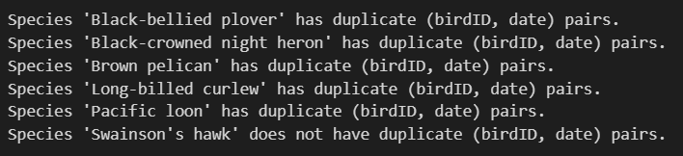
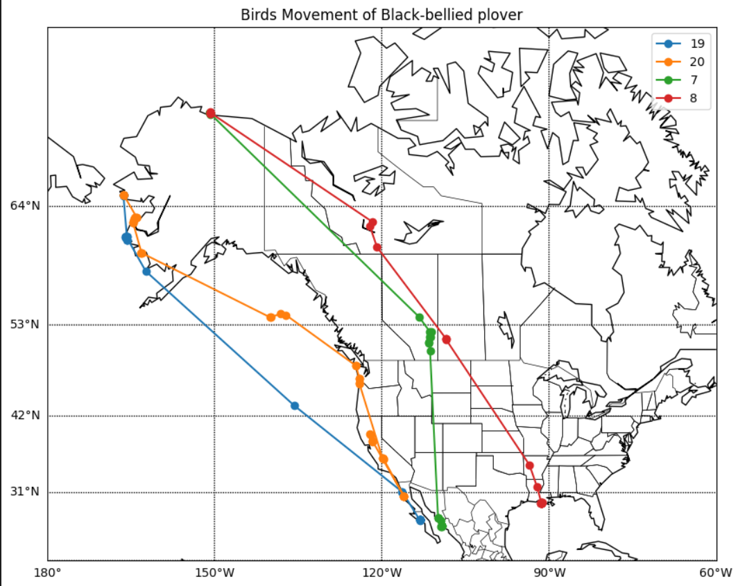
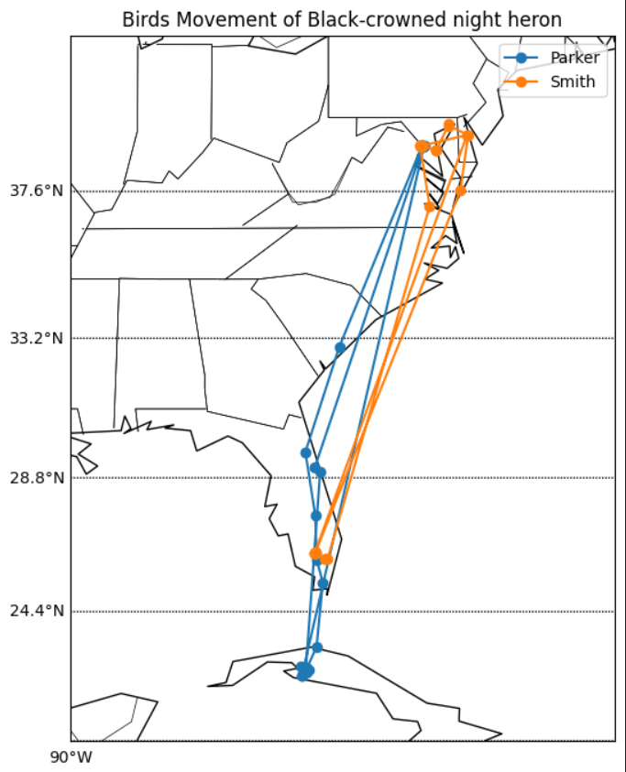
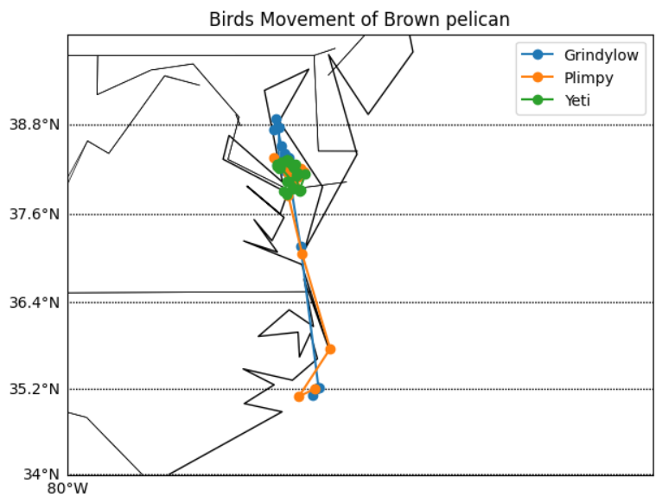
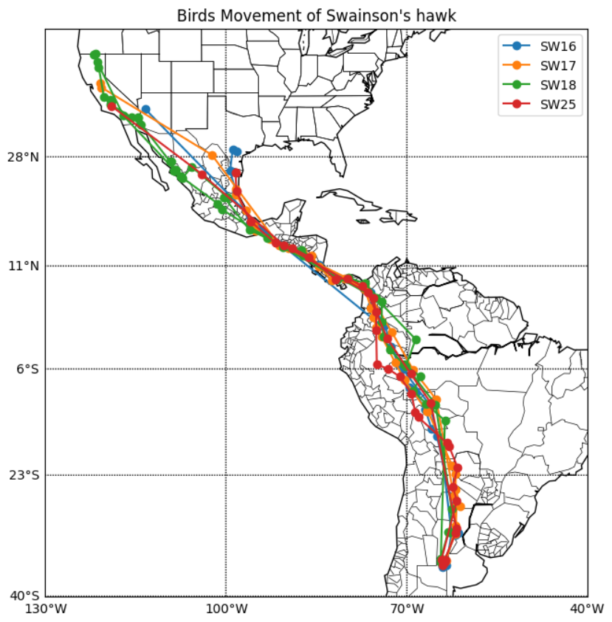
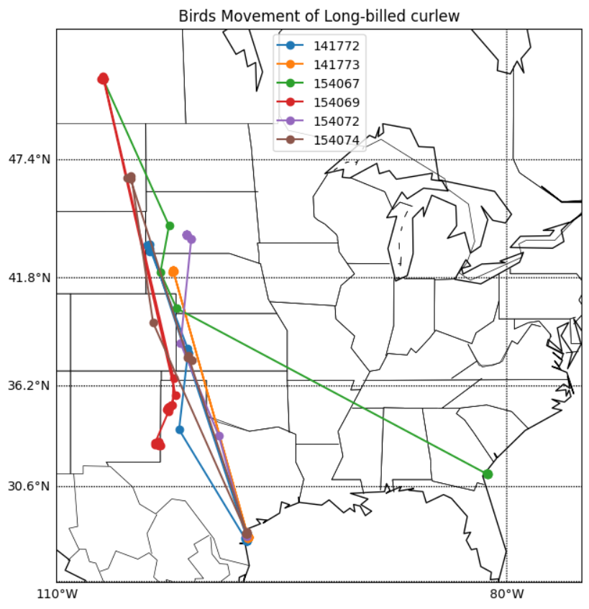
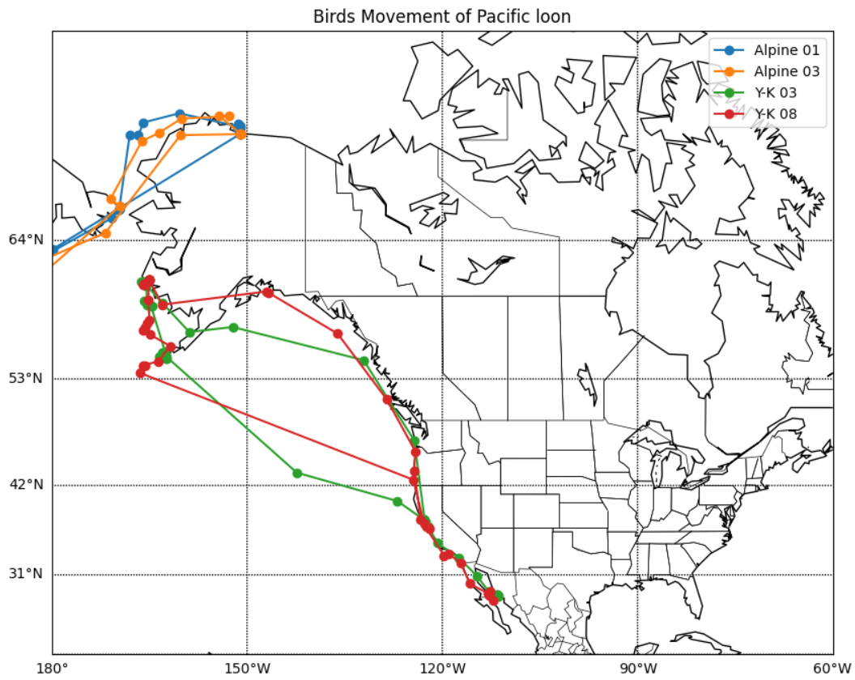
Smithsonian National Zoo data

Slide 7
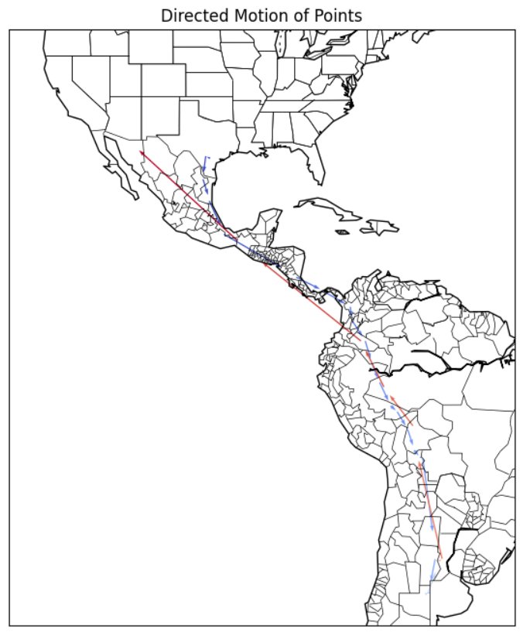
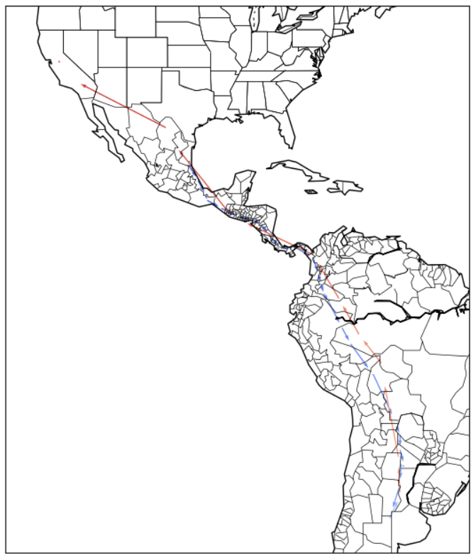
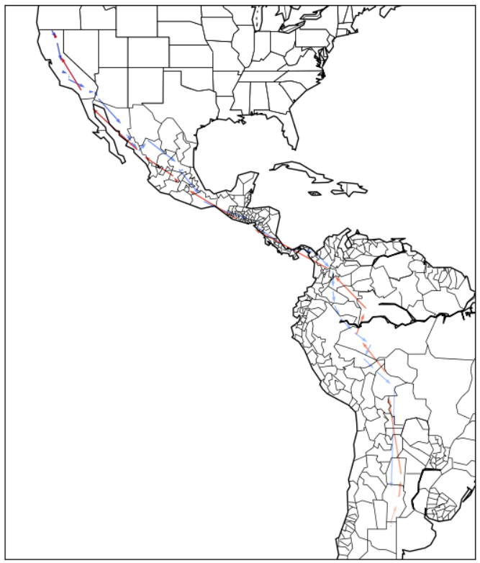
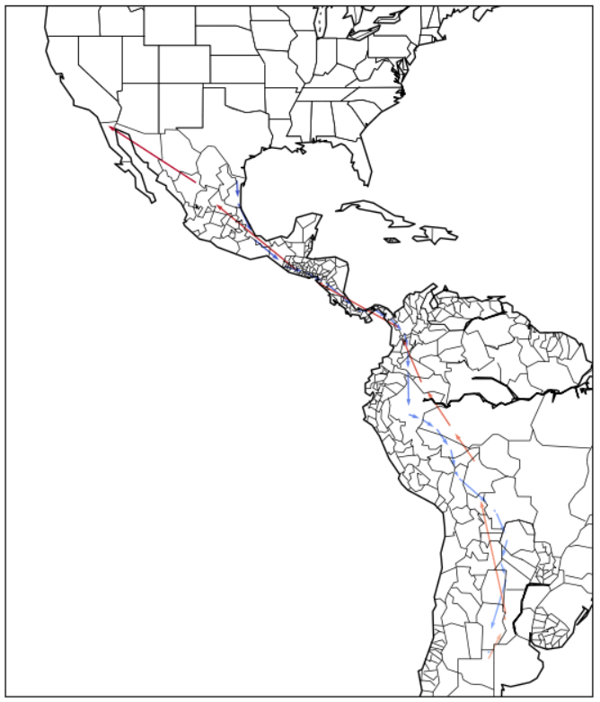
Taking a closer look at Swainson's hawk
SW16
SW17
SW18
SW25

Slide 8
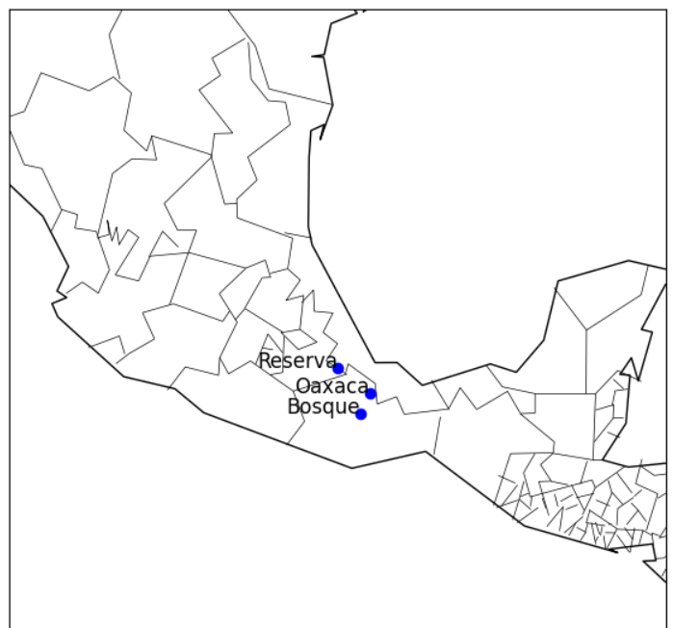
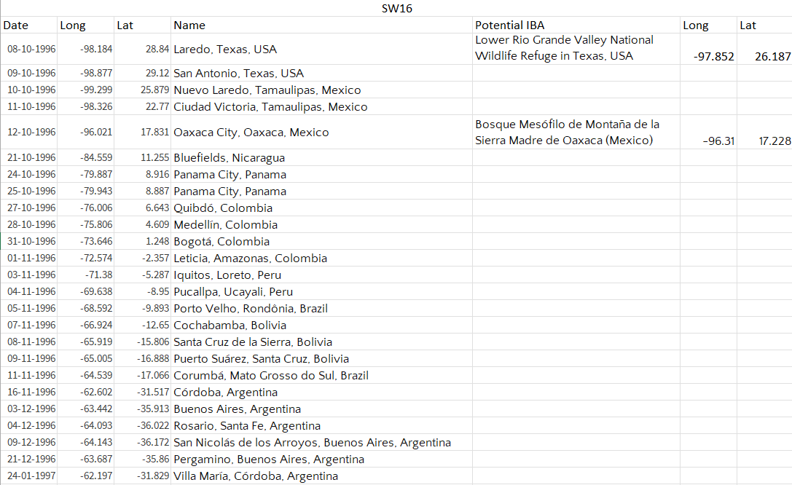
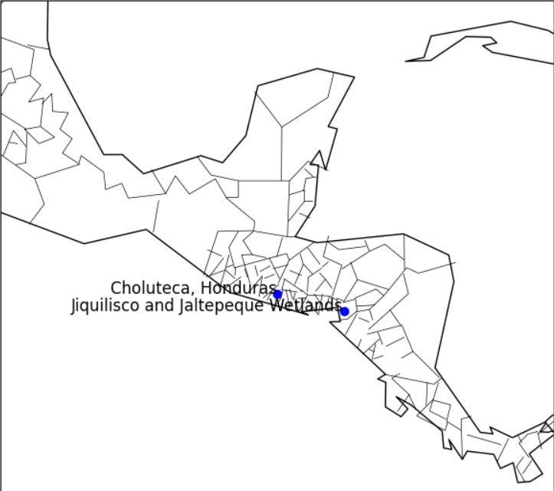
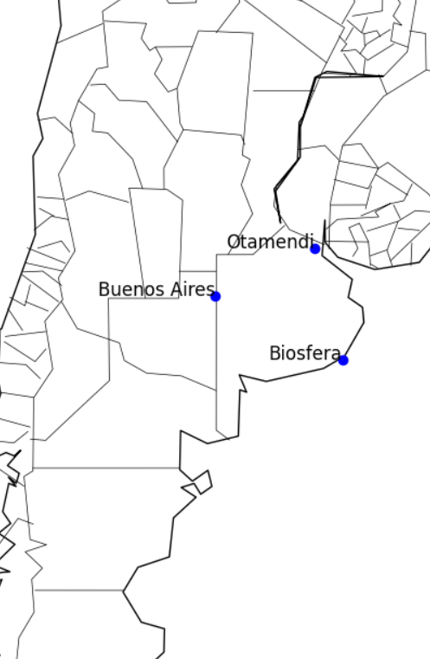
Attempt to create a common path
Was not fully created as only few points fell under some IBA
Checking proximity of collected data with IBAs

Slide 9
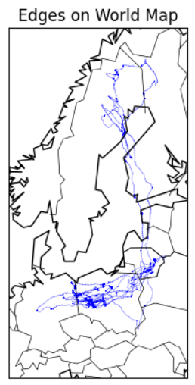
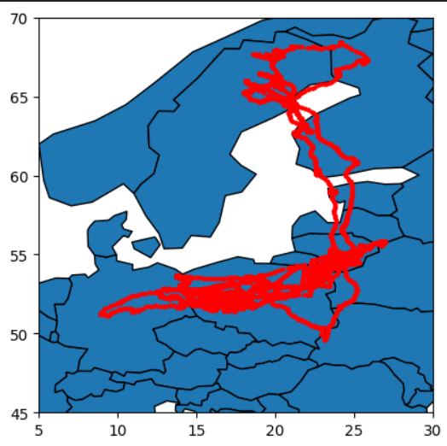
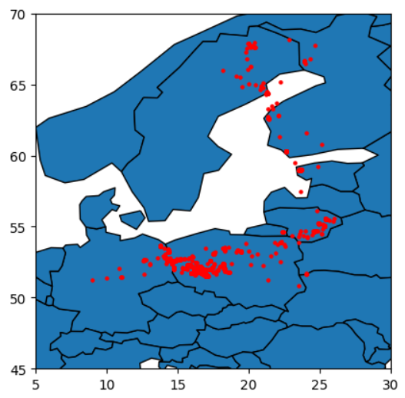
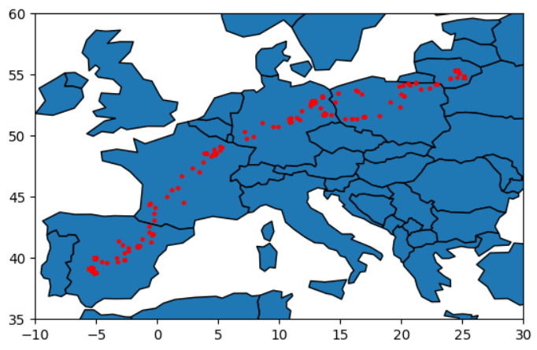
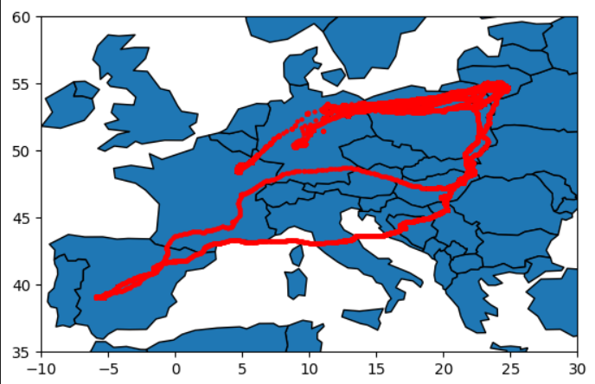
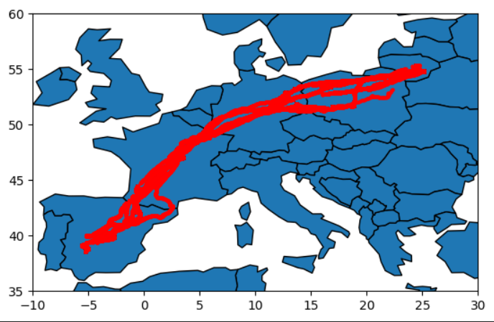
MoveBank data
Data is location of multiple birds of same species (basically a scatter plot)
Daily-averaged locations
3 datasets on common crane over 3 different years

Slide 10
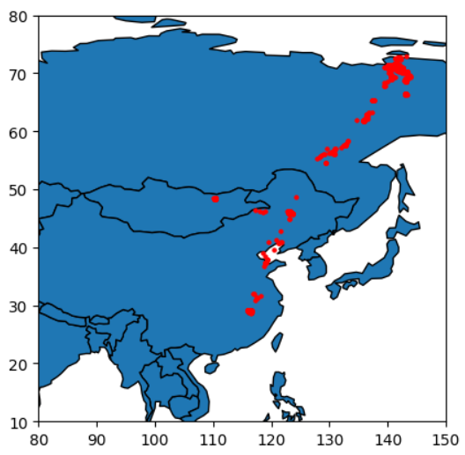
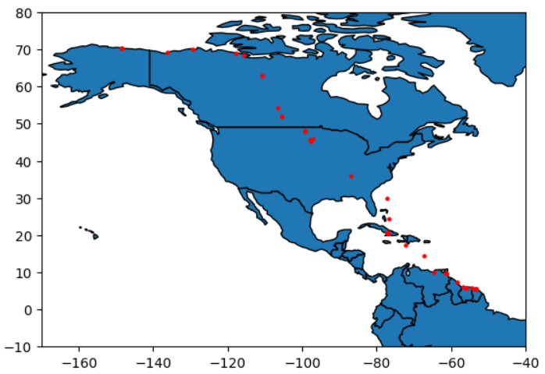
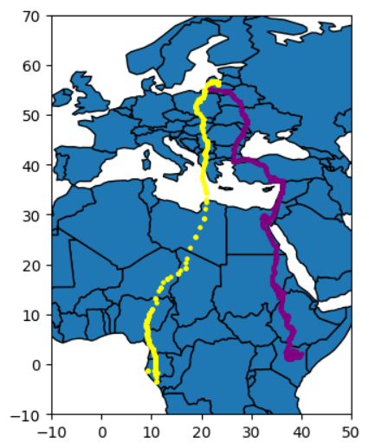
Siberian
Crane
Arctic
Shoebird
Honey Buzzard
And
Spotted Eagle

Slide 11
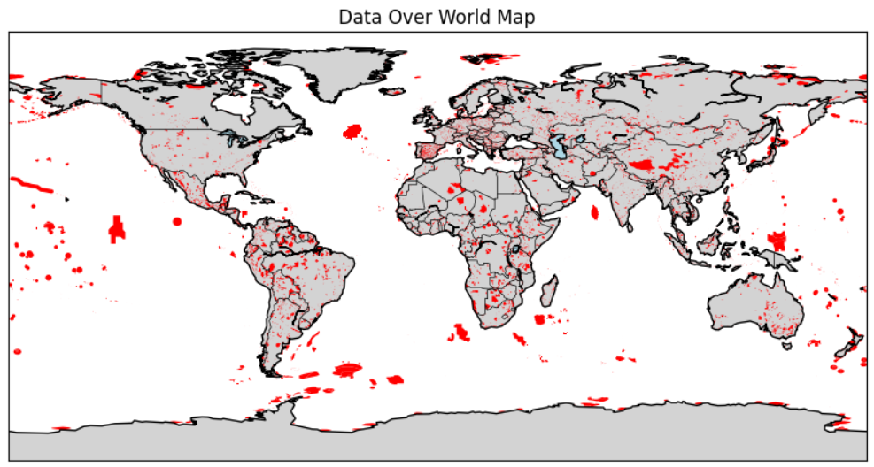
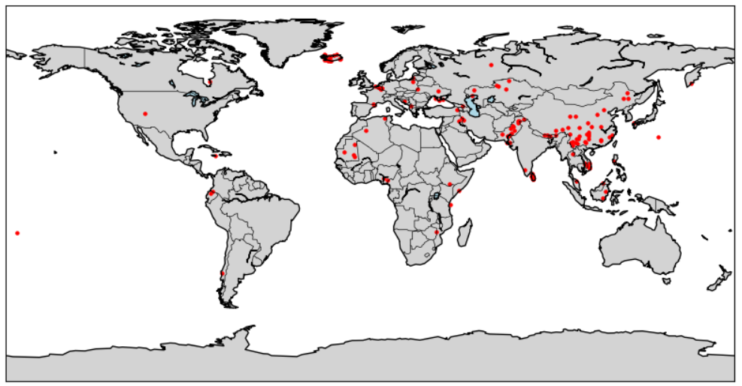
BirdLife Datazone IBA data
Point locations
Polygon boundary
region spread

Slide 12
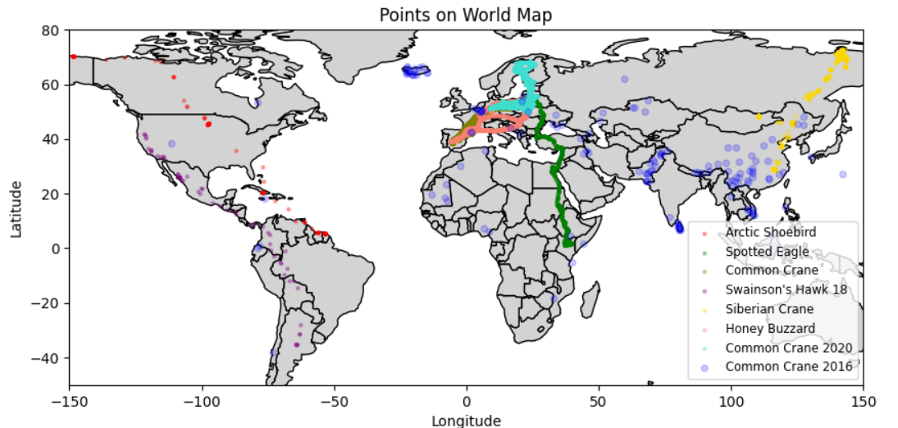
Overall View

Slide 13
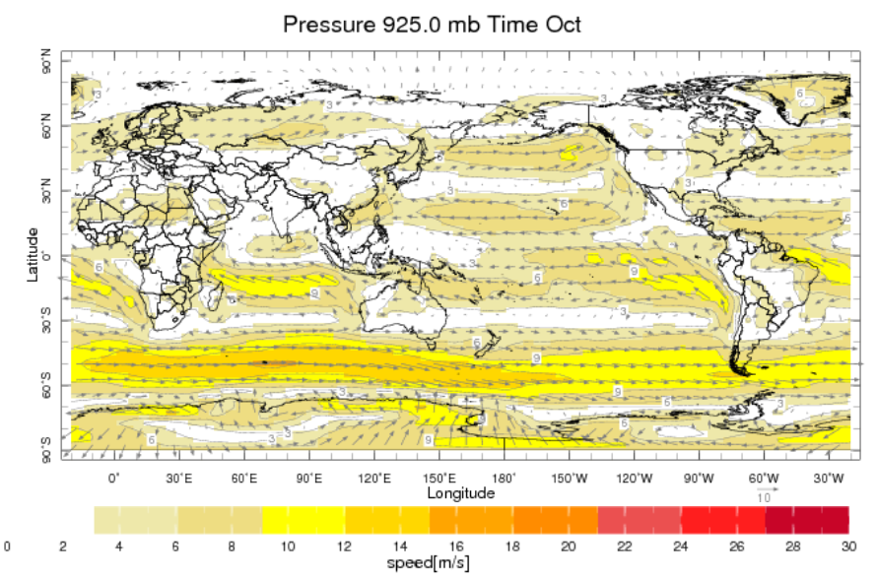
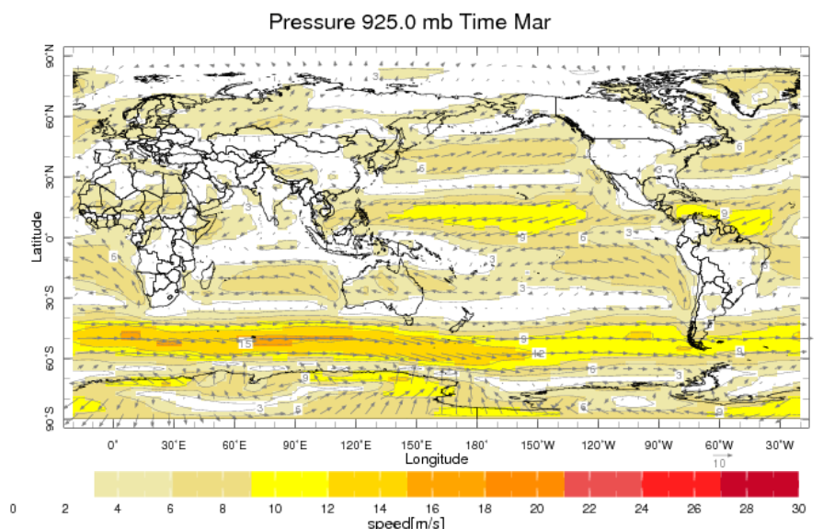
https://iridl.ldeo.columbia.edu/maproom/Global/Climatologies/Vector_Winds.html?P=925&T=Mar

Slide 14
Network Construction
Haversine
Dispersal Probability
Swainson’s Hawk
Github Repo: https://github.com/YYashraj/Bird-Migration-Network

Slide 15
What after the mid-semester roadblock?
What mistake were we making
After a not so great attempt at constructing an IBA-centered network involving birds world-wide, we decided to focus our attention first on one of the earliest data we acquired, the Smithsonian’s data on Swainson’s Hawk as it had an almost overlapping pattern amongst all its individual tracked birds so we planned/hoped to figure out what we could do for this species which we may later expand for few other aviators.
Well this dawned on me when I was watching the documentary on the movie night, we made the same mistake those folks made; we never plotted the degree distribution!

Slide 16
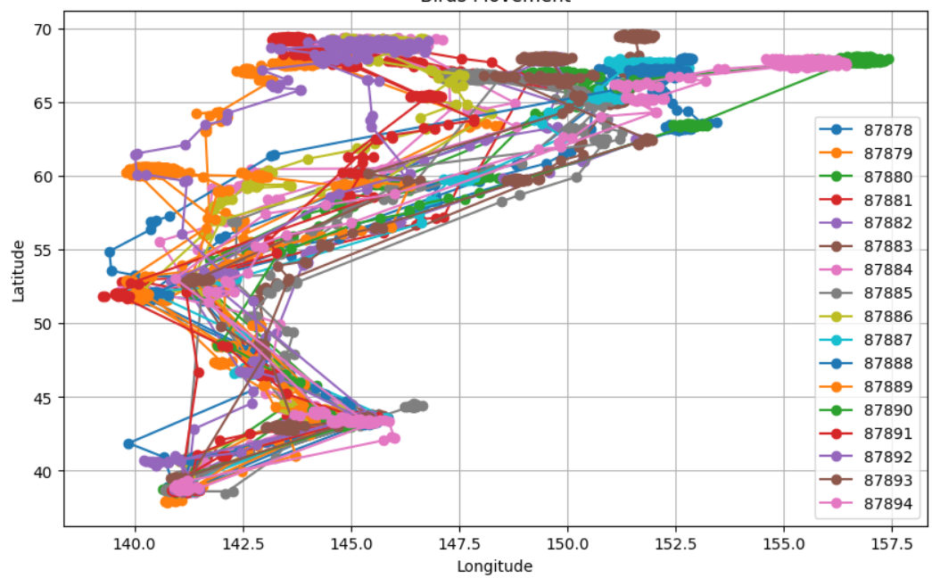
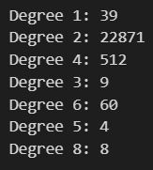

We plotted that for Whooper Swan (data from MoveBank). We had assumed that since we only got a set of coordinates of where a tracked bird had been, connecting consecutive n nodes would only result in just a trail with n-1 edges, meaning almost all nodes would have degree=2 (though that did turn out to be the case for Swainson’s Hawk though, bummer).
To our surprise and excitement we got a very different distribution then we had imagined. This thus meaned that different birds were indeed crossing over the same points/locations giving rise to some degree distribution, and in turn a ‘network-esque’ network.

Slide 17
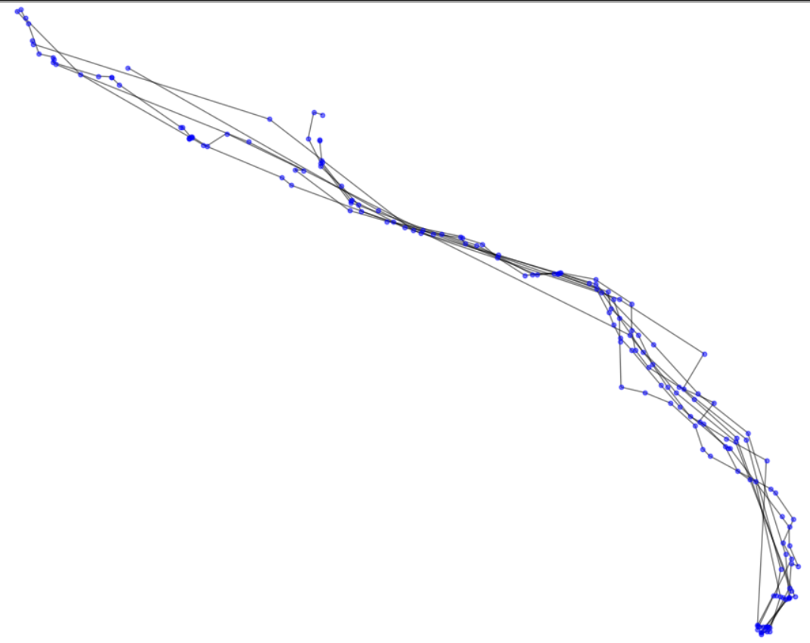
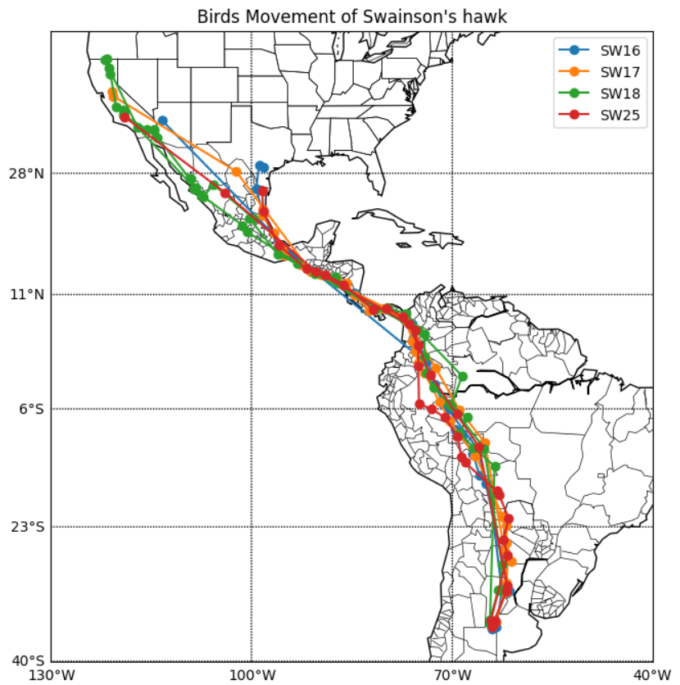
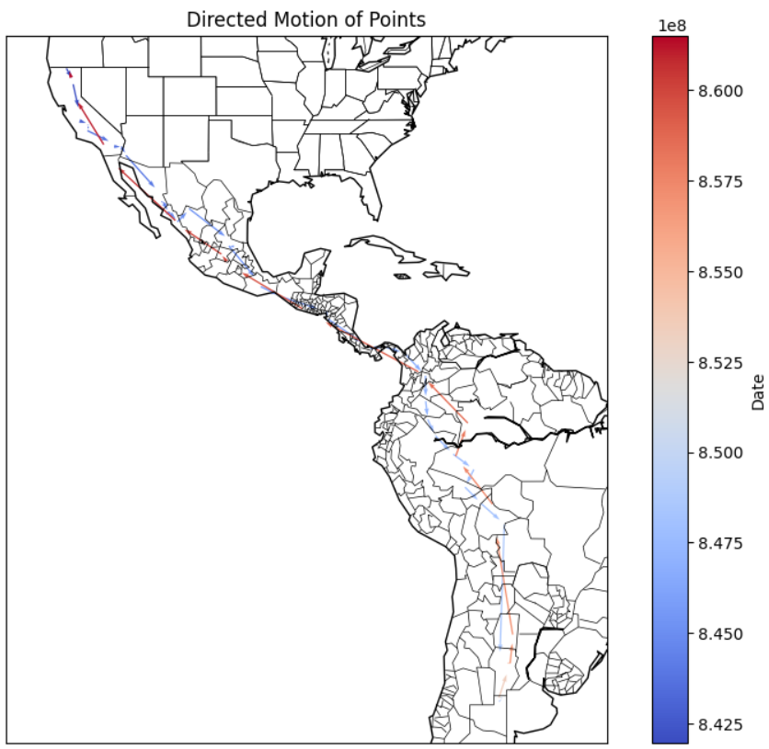
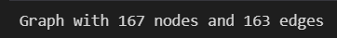
Well with the success/ discovery on the previous data, we looked forward to achieve the same with SWH (Swainson’s Hawk). However, we were left disappointed.
Well atleast the data kinda confirms that migration tends to happen in a closed cycle; the starting and ending point over the year are pretty close
This is nothing but ⅀(n-1)=N-4. So basically our ‘network’ is just four independent trails. Not at all suitable for any network analysis.

Slide 18
A different attempt at network construction
It took few weeks but we came to terms with the fact that we won’t readily find a data on the web that will map out a good network for us to work upon. What we have now, and probably still get even after digging more sites, are just coordinates of where a bird has been, effectively, our network’s nodes. It was completely up to us now how we would create a network out of this data. (We found out pretty late that it was quite a common thing in network science research to face this problem; the edges in such cases would be constructed using some preconceived notion or hypothesis regarding the data in subject)
Some papers we came across used some probabilistic or mathematical model being used, after some node pre-processing and some additional constraints on links between nodes, to construct edges of the network. This could give a more network-like representation of the migratory route.

Slide 19
A different attempt at network construction
One such paper was Detecting Critical Scales in Fragmented Landscapes by Keitt et.al (https://www.ecologyandsociety.org/vol1/iss1/art4/). It developed a method to quantify habitat connectivity between different patches. It used distance as a parameter of probability of whether two nodes could be connected. We were planning to test this technique for our network construction, however we didn’t do it as we later felt that the two problems were slightly different from each other. In their problem, few habitat spots were already forming clusters and their algorithm was more focused on finding inter-habitat relationships, which is not our case.
So instead we devised a different, and much simpler (why didn’t we think of this earlier), approach to our network construction. Since all the tracked birds of SWH were of the same species they would move due to same reasons, for breeding or climate etc. This means that their weather requirements would be similar so it is quite possible for bird-1 to pass through few points that some other bird had passed through. Moreover, we found that SWH likes to be where it is summer. So when it leaves US or when it return back there, the weather of the places it’s been to would be similar. So it can use nodes from one direction traversal in that of other direction travel as well. This was the reason to reduce our network from directed to undirected.

Slide 20
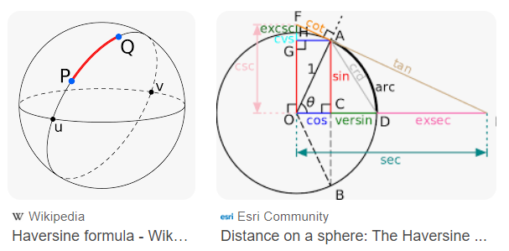
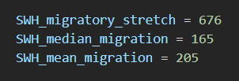
A different attempt at network construction
We defined an edge in our network as a link between two locations if SWH is capable of a direct non-stop flight between them. So to quantify this we calculated the max distance a SWH travelled in a day acc. to our data (we termed it migratory stretch). We also calculated median and mean distance they cover in a day (will be used in next slide).
Over the previous network, we made new links between two nodes if the distance between them is less than the migratory stretch. For distance we didn’t use Euclidean. To take into account the spherical nature of the surface, we preferred to use Azimuthal Projection/ Haversine.

Slide 21
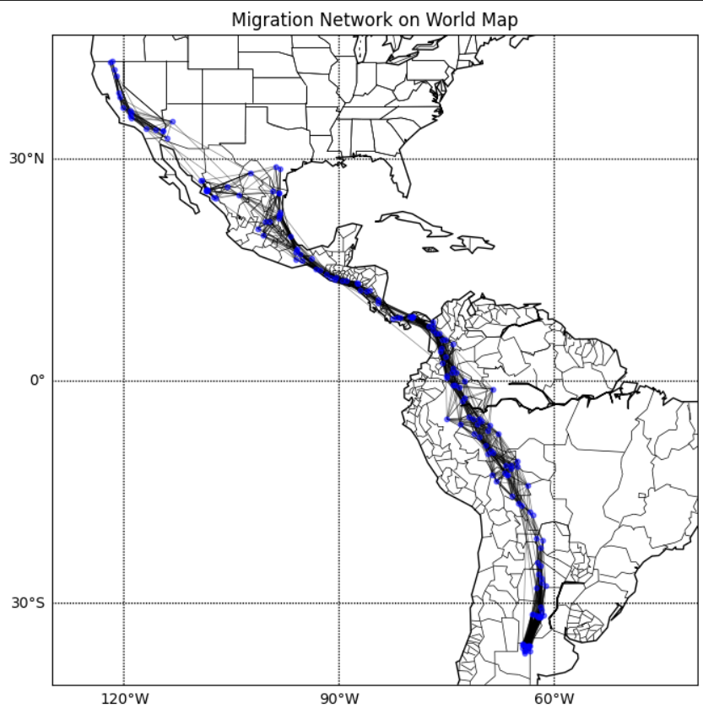
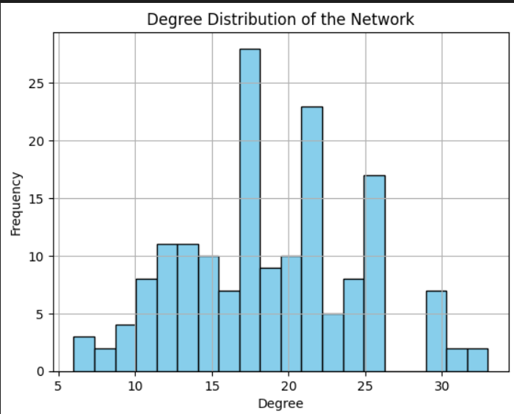
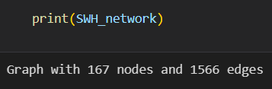
This method of construction gives the following network. The number of edges has nearly grown 10 folds and we get a good degree distribution too.

Slide 22
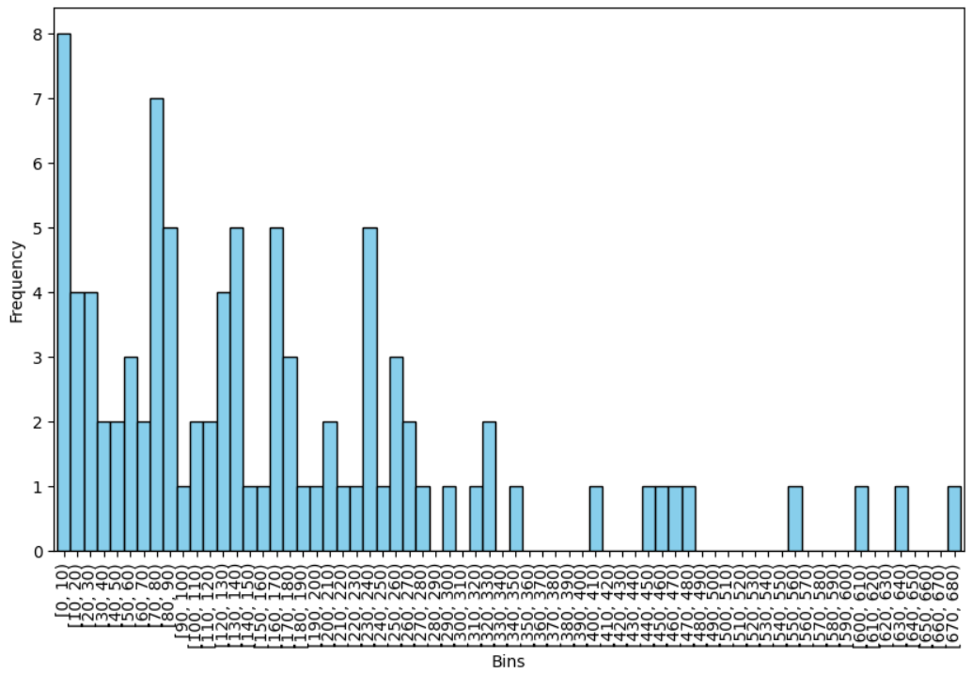
A different attempt at network construction
We now have a decent network ready but something is missing. As you can see in the graph on the right, SWH has travelled the length of its migratory stretch but its frequency is way less as compared to smaller distances. It implies that birds don’t often to travel large distances when smaller travel
is possible. But in the current model, edges with larger distance have same importance as those with smaller ones. What’s the fix then? Its making the network weighted!

Slide 23
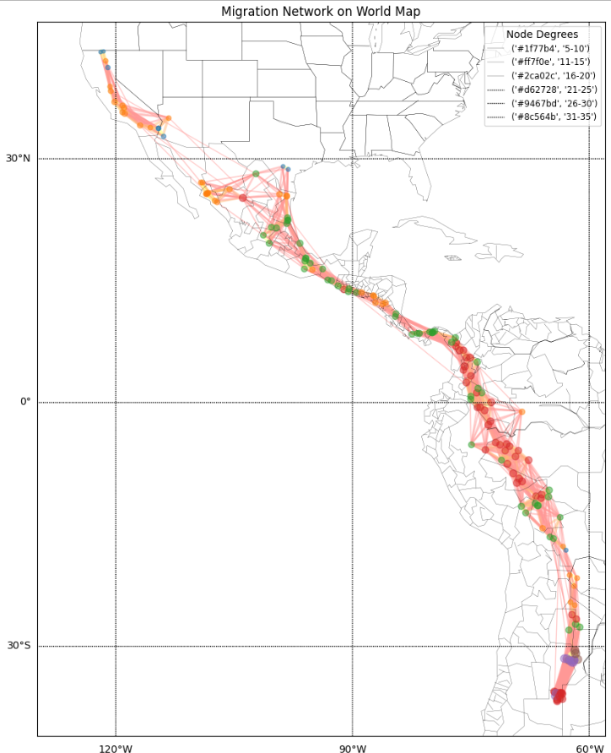
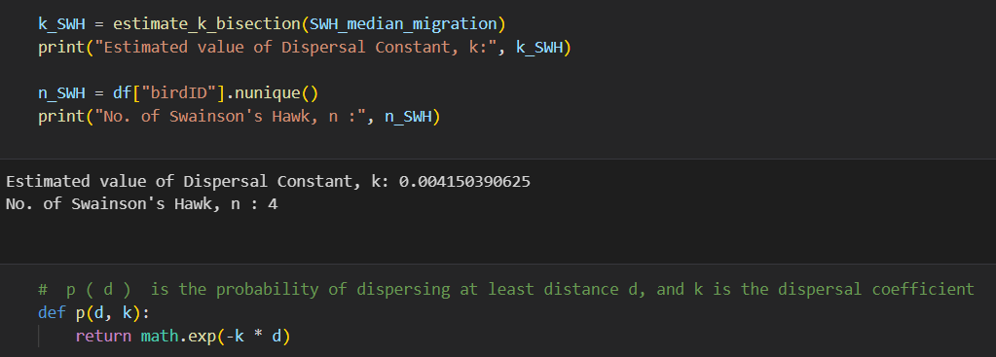
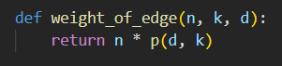
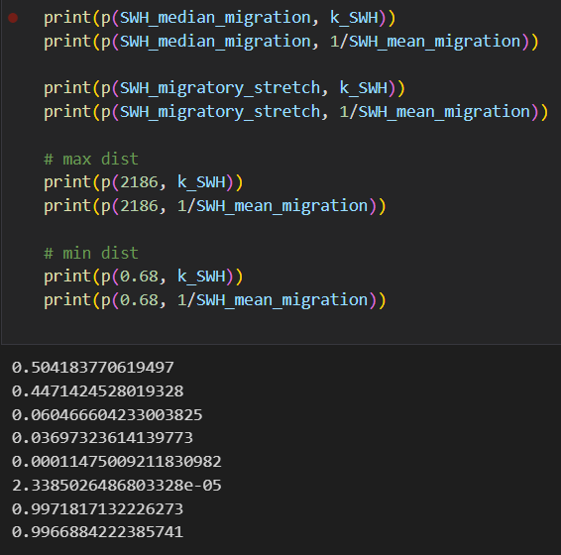

Slide 24
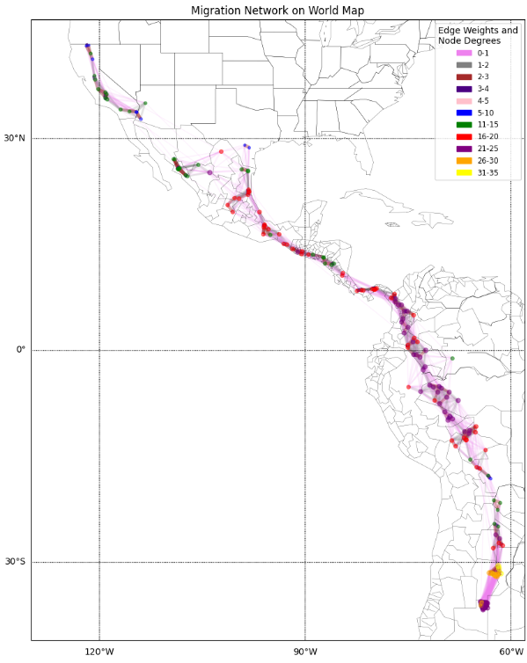




3<weight<4
2<weight<3
1<weight<2
0<weight<1

Slide 25








Trying different network construction

Slide 26





Trying different network construction

Slide 27



We figured out betweenness centrality of all nodes and noticed choosing 0.09 and greater nodes give us important nodes in dispersed regions. We then highlighted those nodes in hope that we might be able to link it with some other measure on our way.

Slide 28



We noticed points with high closeness centrality are in the range -10 to 10 Latitude and some being near 15 in the mexican region. So we colored them differently when highlighting them. First thought was that the node near the equator could be an important point and hence we tested it out in the robustness part. Also the points in the Mexican region are important because of the most narrow landscape in bird’s complete network.

Slide 29




Formed Communities using networkX inbuilt function and noticed an important pattern. The nodes which had high betweenness centrality were nicely distributed along these communities. Also these communities represent different regions of the bird network as represented by the subsequent graph.

Slide 30



Found out about Ecological Corridors - Regions connecting different wildlife populations separated by human activities/buildings.
Also calculated other metrics which just proved the high dense nature of the graph.
Conducted a p-value test on the degree-distribution to check whether it follows a Poisson Distribution but it doesn’t.

Slide 31
Network Reconstruction
Cost Function
Trail Reconstruction Algorithm
Vulnerable Nodes

Slide 32


Node Locator
Bird Trails

Slide 33
Shortest Trail Traversal
Algorithm
Brute Force - fast for trail cost computation, exponentially expensive for entire network, hence not suitable
Optimised Algorithm - Time Complexity: O(V*E) Computes least cost and returns path of travel by backpropagation through predecessors

Slide 34



Cost Function
Limitations of simple cost function

Slide 35







Cost Function
Experimenting with cost function

Slide 36





Final Cost Function
For algorithm refer to reconstruction.ipynb in our repo

Slide 37
Influence of temperature on migration network
Temperature as a Migration Compass: Swainson Hawk follows a preferential migration path advancing towards higher temperatures.
Thermally Guided Journeys: Over 80% of the migration paths were green edges, highlighting its preference for warmer regions during their extensive migrations.
Climate-Influenced Routes: This predominance of green edges suggests potential vulnerability to global climate changes.

Slide 38
Statistical Analysis of temperature dependency
We tracked the movement of Swainson Hawk, and noted the temperature of that place on that day.
We compared the temperatures and if the new temperature is higher than its previous temperature (with 1⁰C tolerance), and then marked that edge to be green , else red. We aim to check if there is any correlation between the bird migration route and temperature of points on that route.

Slide 39


Temperature Dependence Plots
We see a very heavy temperature biased bias in the route.
In its southward path, the bird travels 82.53% towards higher temperatures. In its northward journey, the statistical figure is 83.13%.

